Slide 1
Hurricane Visualization Hurricane Isabel (2003) Hurricane Katrina (2005)
Matthew Streicher
Kunal Manjare

Slide 2
Data
2004 IEEE Visualization Contest
Hurricane Isabel ~ 40GBs of data
Each variable has 48 time steps associated with it
1 time step = 1 hour
Inconsistent format documentation
Float or integer format?
Hurricane Katrina data provided in class

Slide 3
What is a Hurricane
Hurricanes specifically occur in the Atlantic Ocean
Rotation
Counter-clockwise in northern hemisphere
Clockwise in southern hemisphere
Low Pressure system
Five categories
cat 1: 74-95 mpg
cat 2: 96-110 mph
cat 3: 111-129 mph
cat 4: 130-156 mph
cat 5: 157+ mph

Slide 4
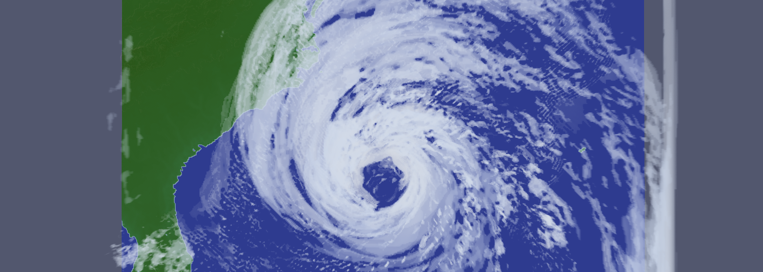
Hurricane Isabel
Volume rendering of Cloud variable
Eye of the storm
Rain bands

Slide 5
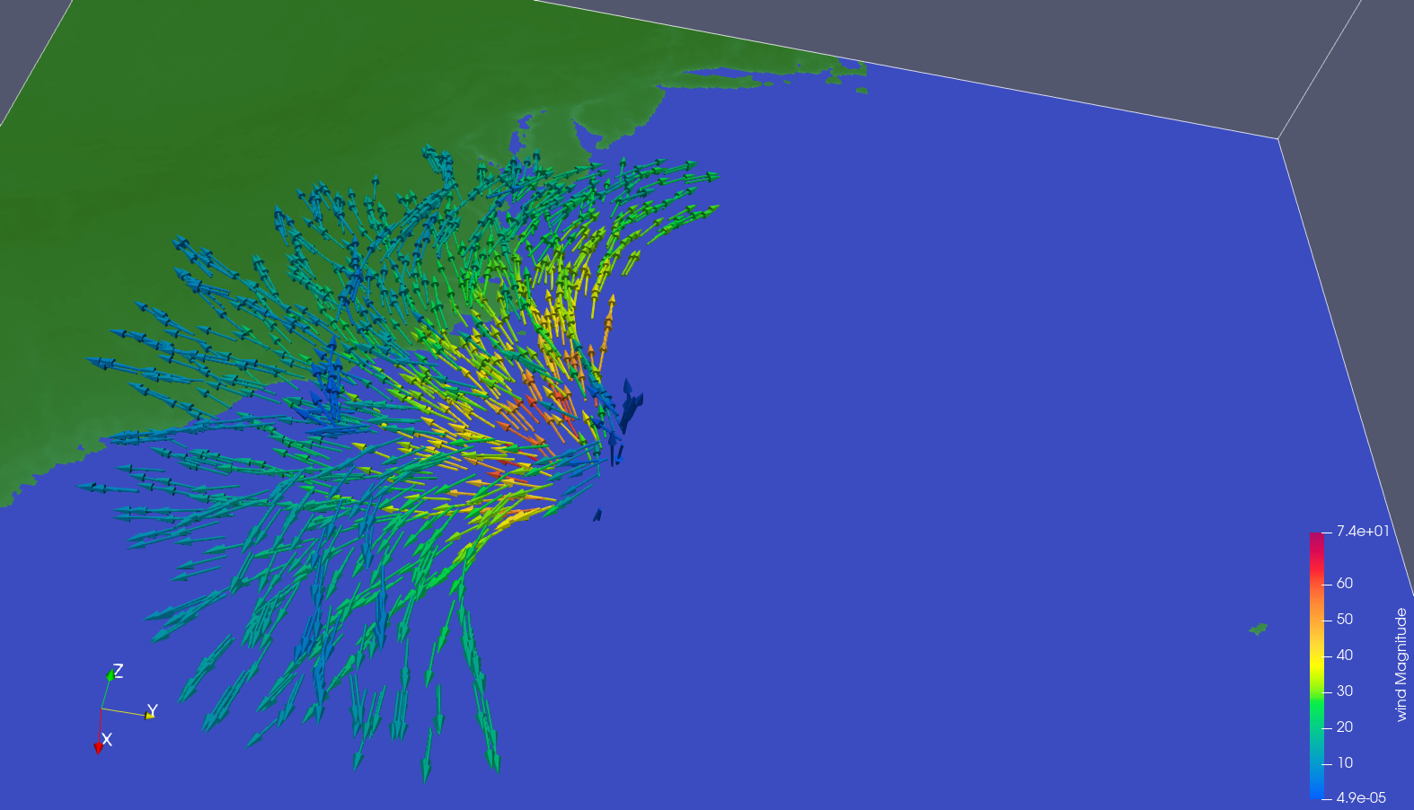
Wind flow and Rotation
Wind flow visualization
Counter clockwise rotation on north side of the storm
Upward draft at the eye of the storm
Increased wind along eye wall
Hurricane Isabel

Slide 6
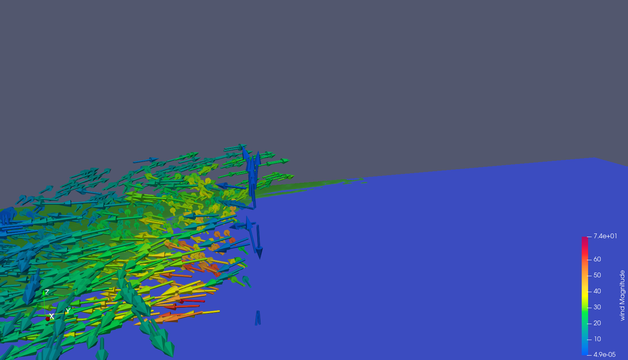
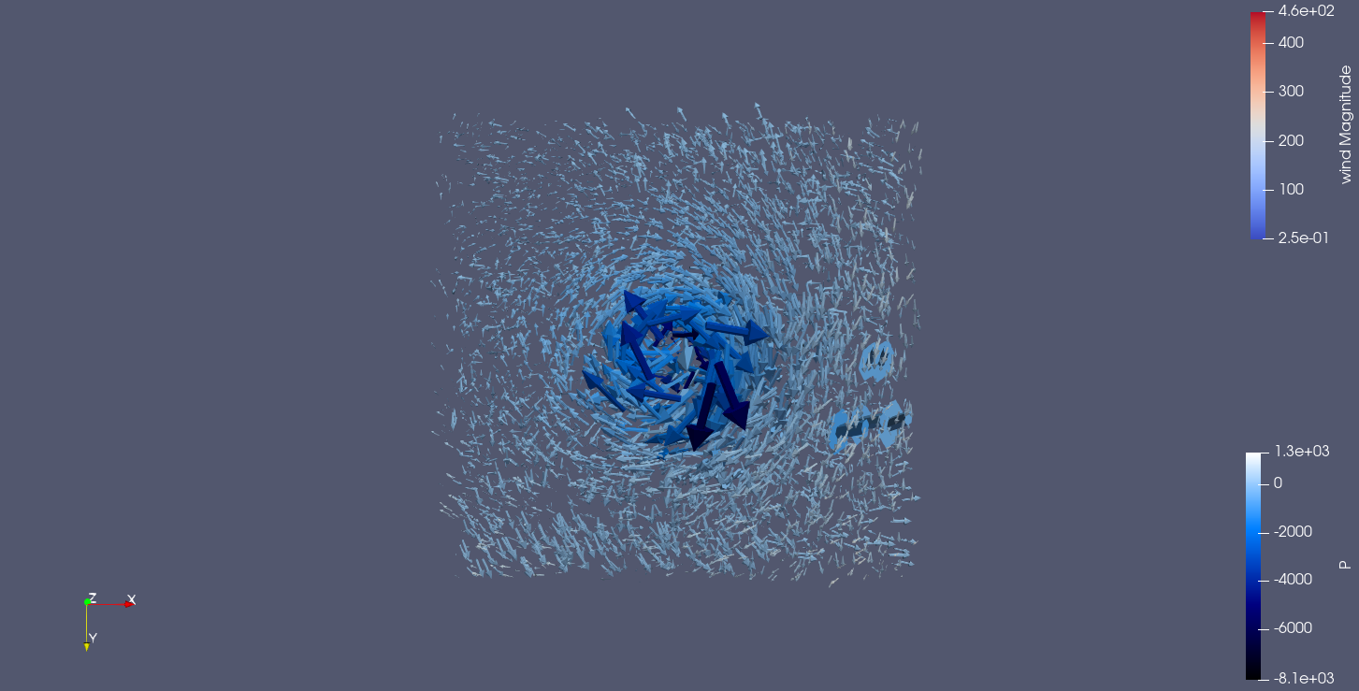
Wind Flow
Hurricane Isabel
Hurricane Katrina

Slide 7
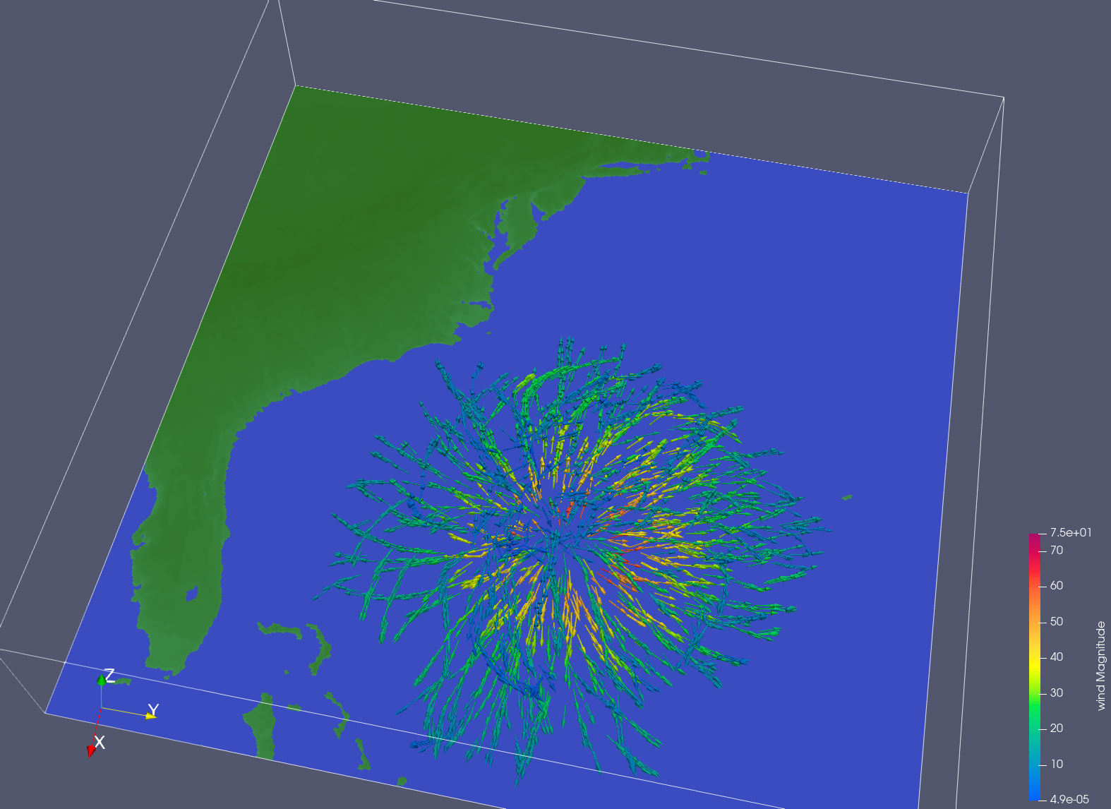
Wind Flow
Point Cloud at eye of the storm
Overall, radiating wind flow from the eye
Counter-clockwise flow on north side
We limited the amount of seed points. Data size was so large it became to computationally expensive
Hurricane Isabel

Slide 8
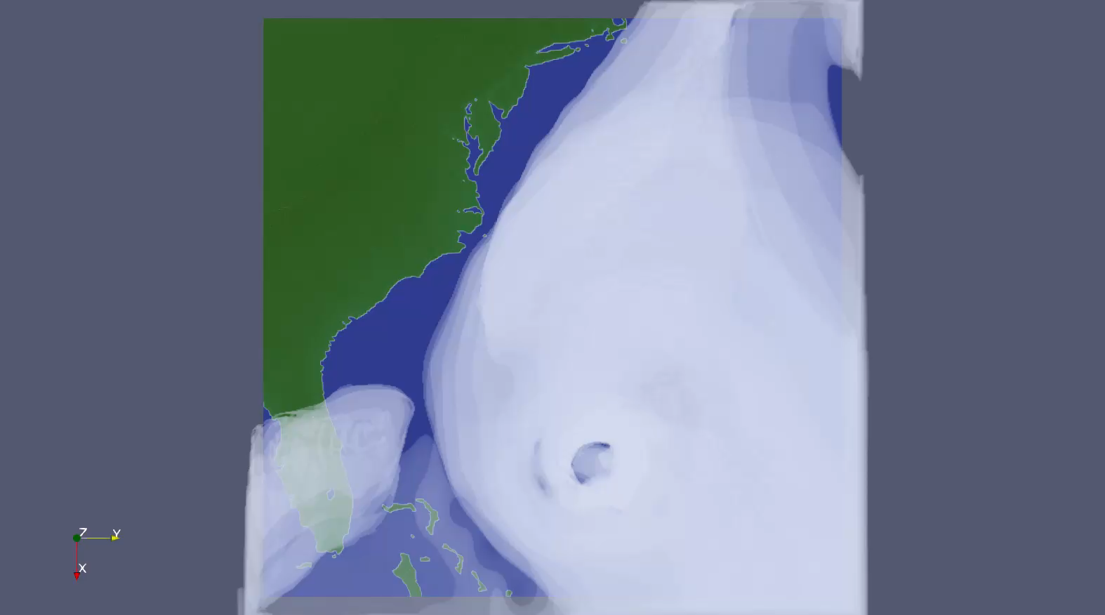
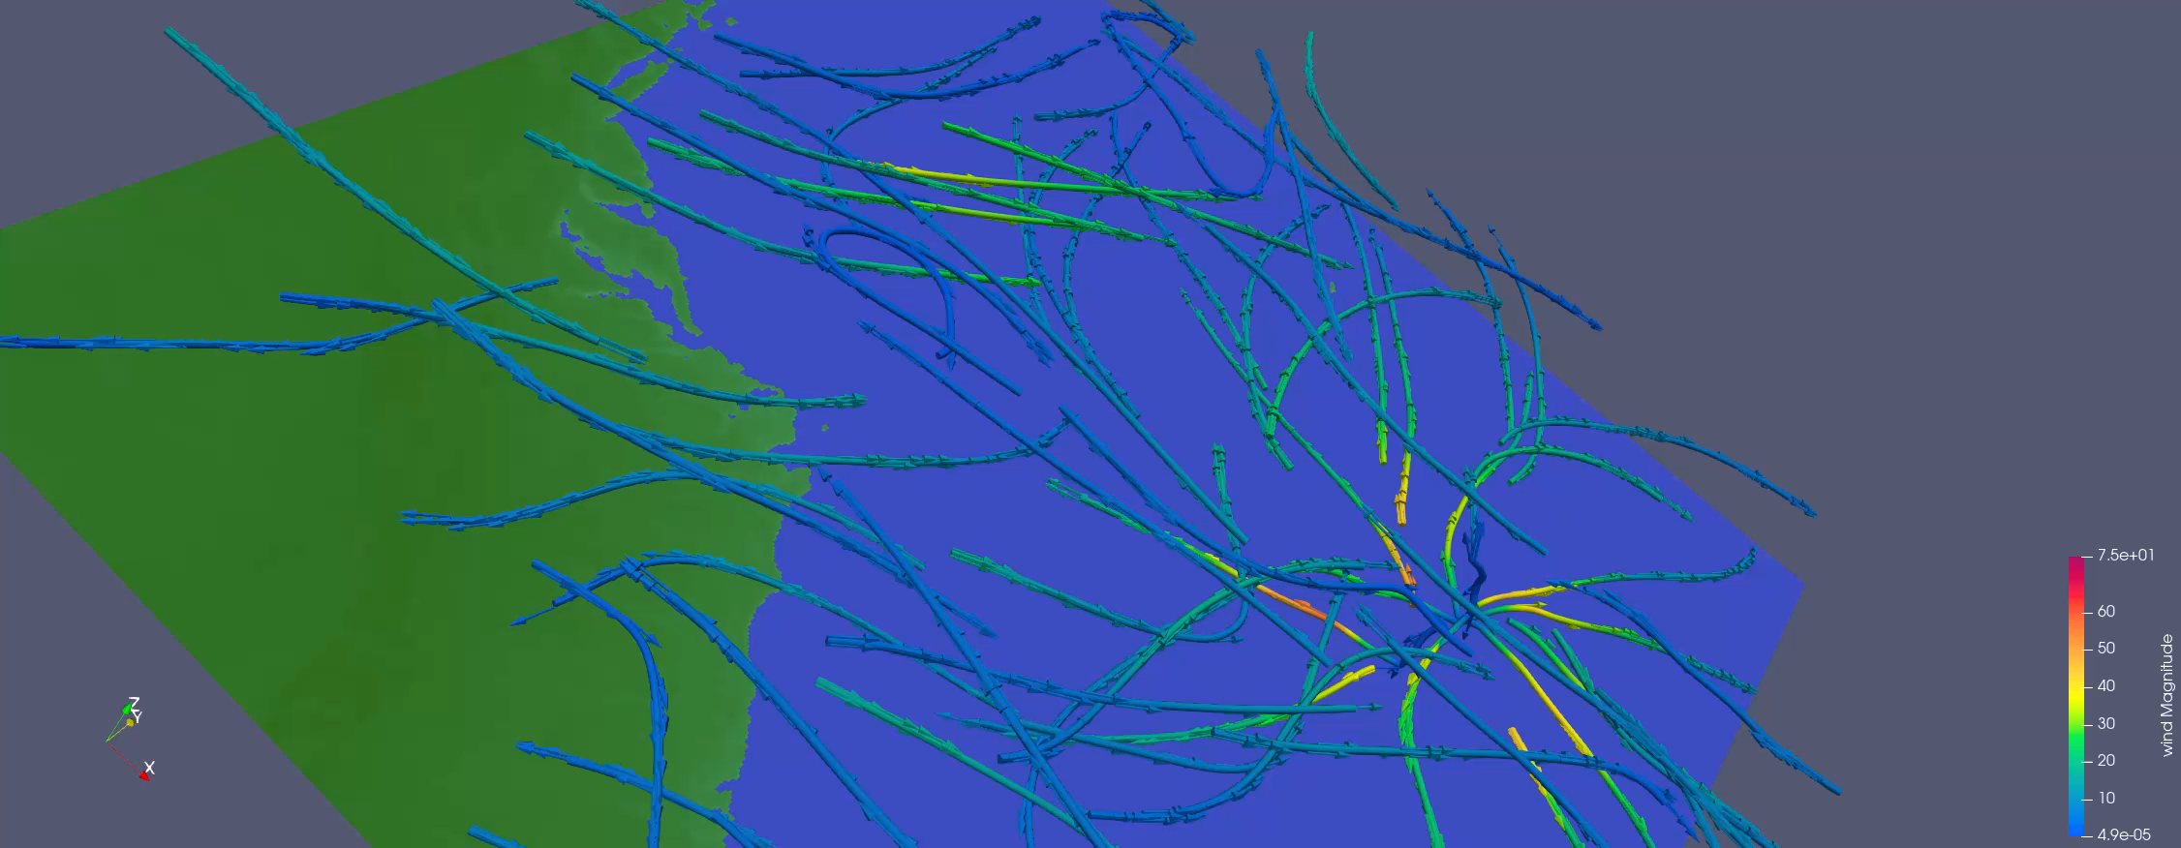
Animations
Cloud Volume
Wind Flow
Hurricane Isabel
Hurricane Isabel

Slide 9
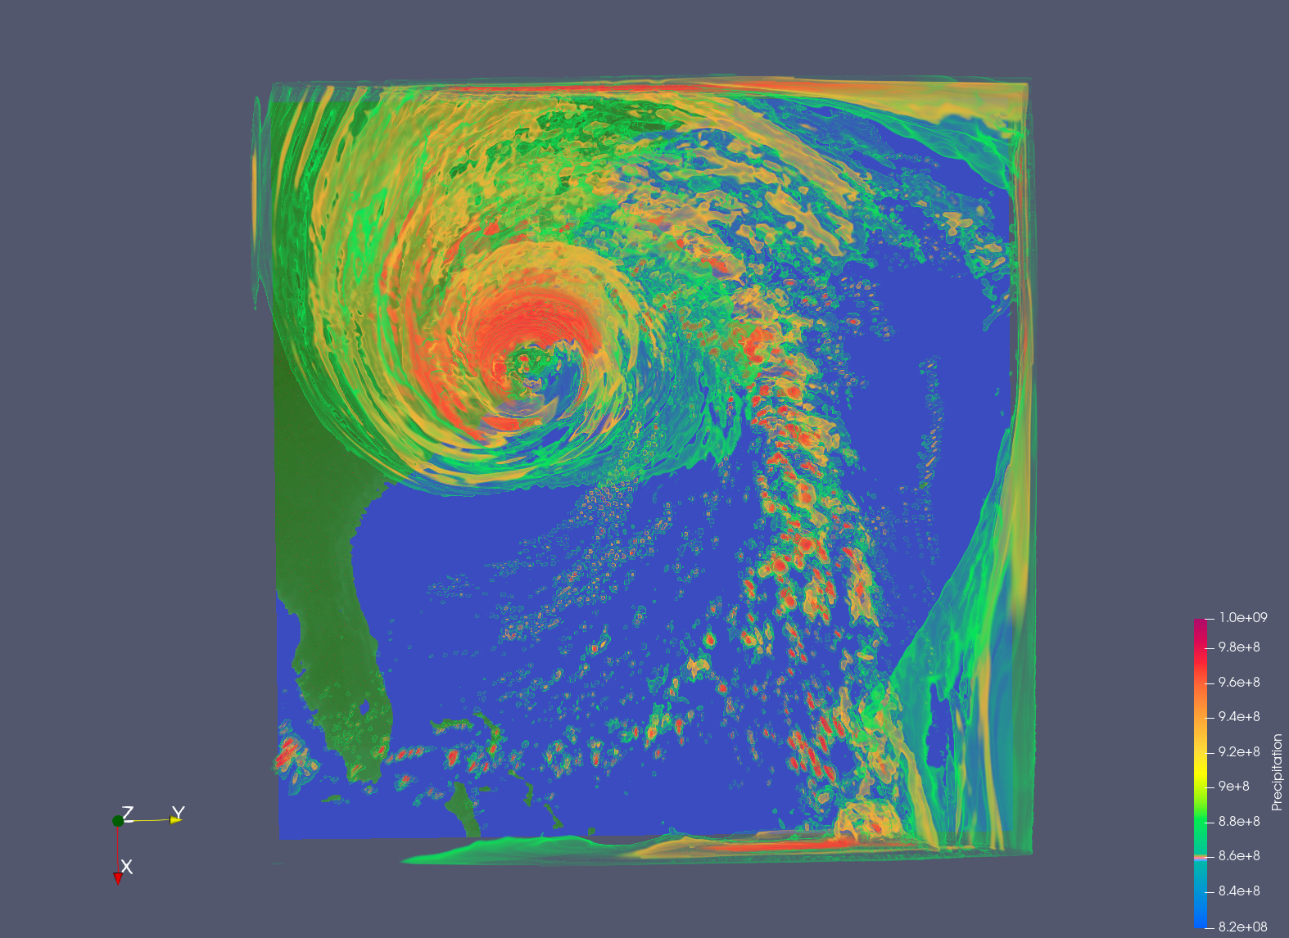
Precipitation
Volume rendering
Hurricane Isabel had strong winds, but more damage occurred due to flooding from immense precipitation
Virginia experienced 20.2 inches of heavy rain fall
$1.85 billion in damage in VA
Hurricane Isabel

Slide 10
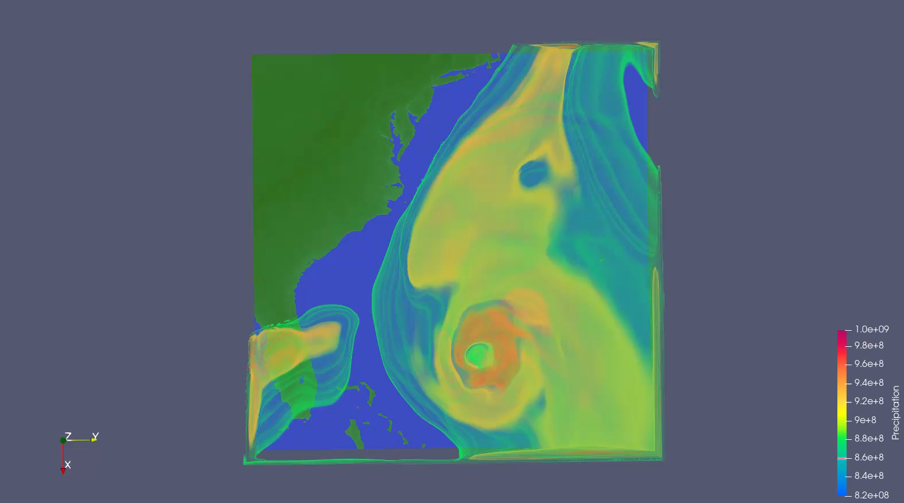
Animation

Slide 11
Pressure
Low pressure systems
Low atmospheric pressure surrounded by areas of high pressure
High pressure = Clear skies, low winds
Low pressure = Inclement weather

Slide 12
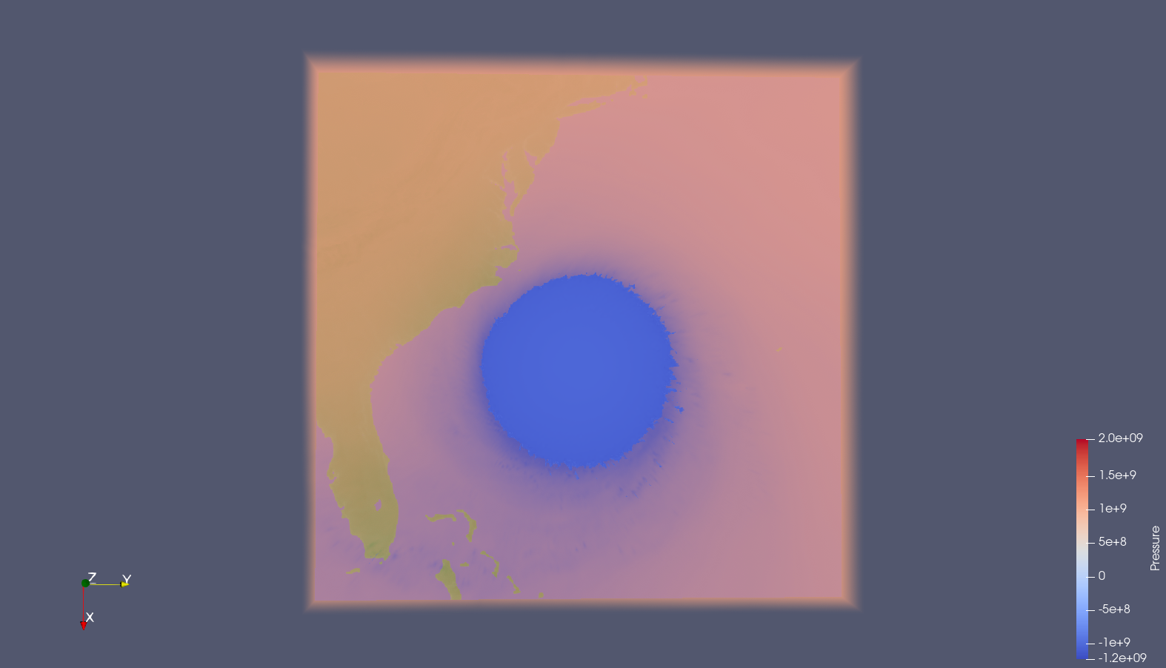
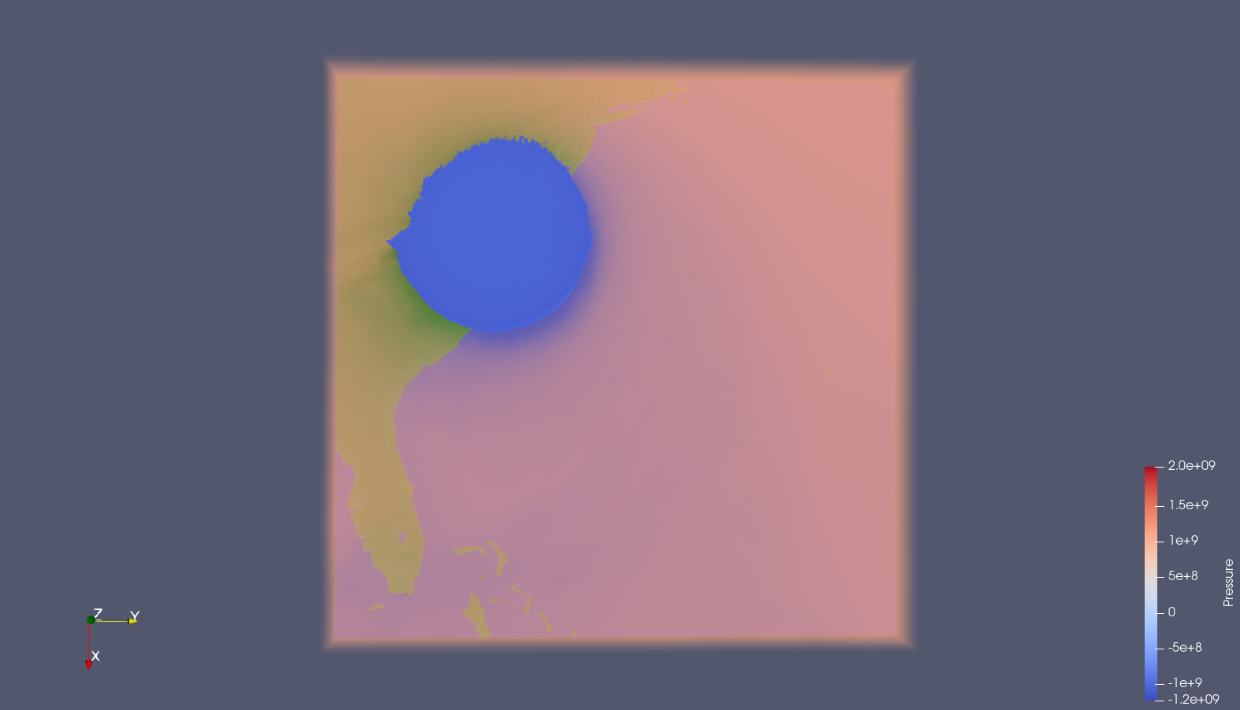
Pressure
24th hour
48th hour
Hurricane Isabel
Hurricane Isabel

Slide 13
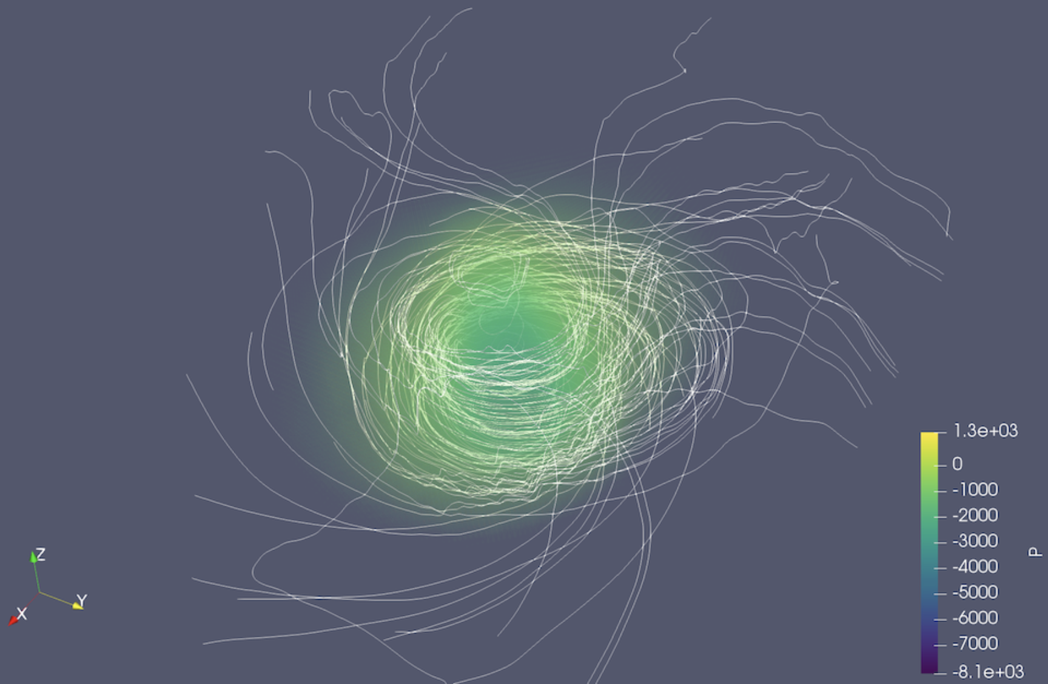
Hurricane Katrina

Slide 14
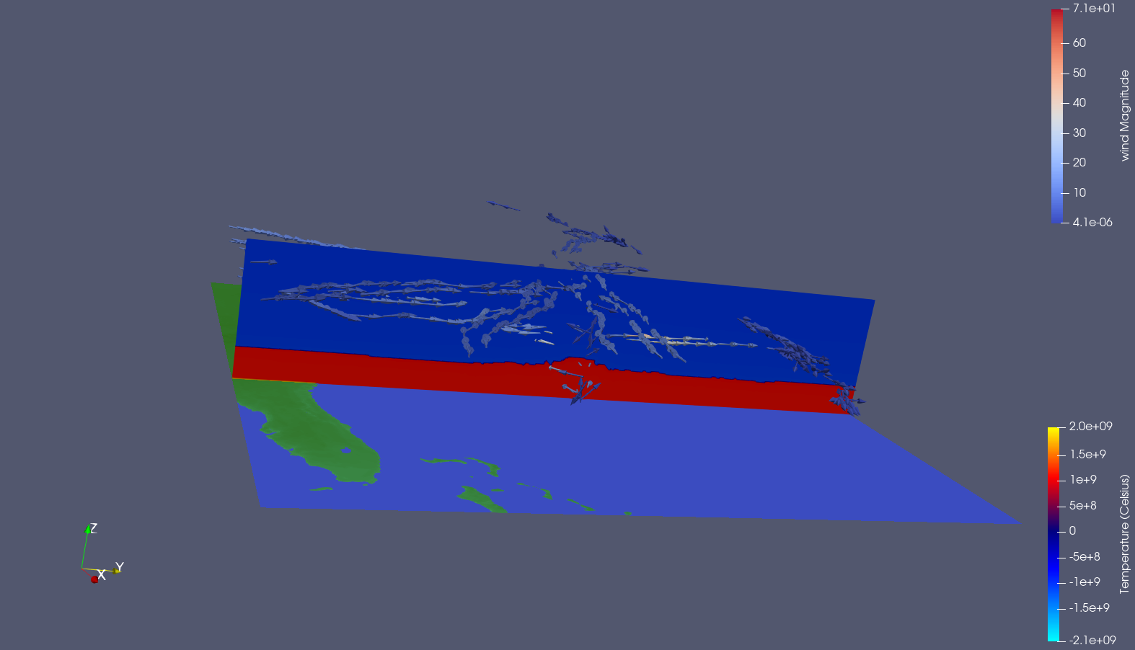
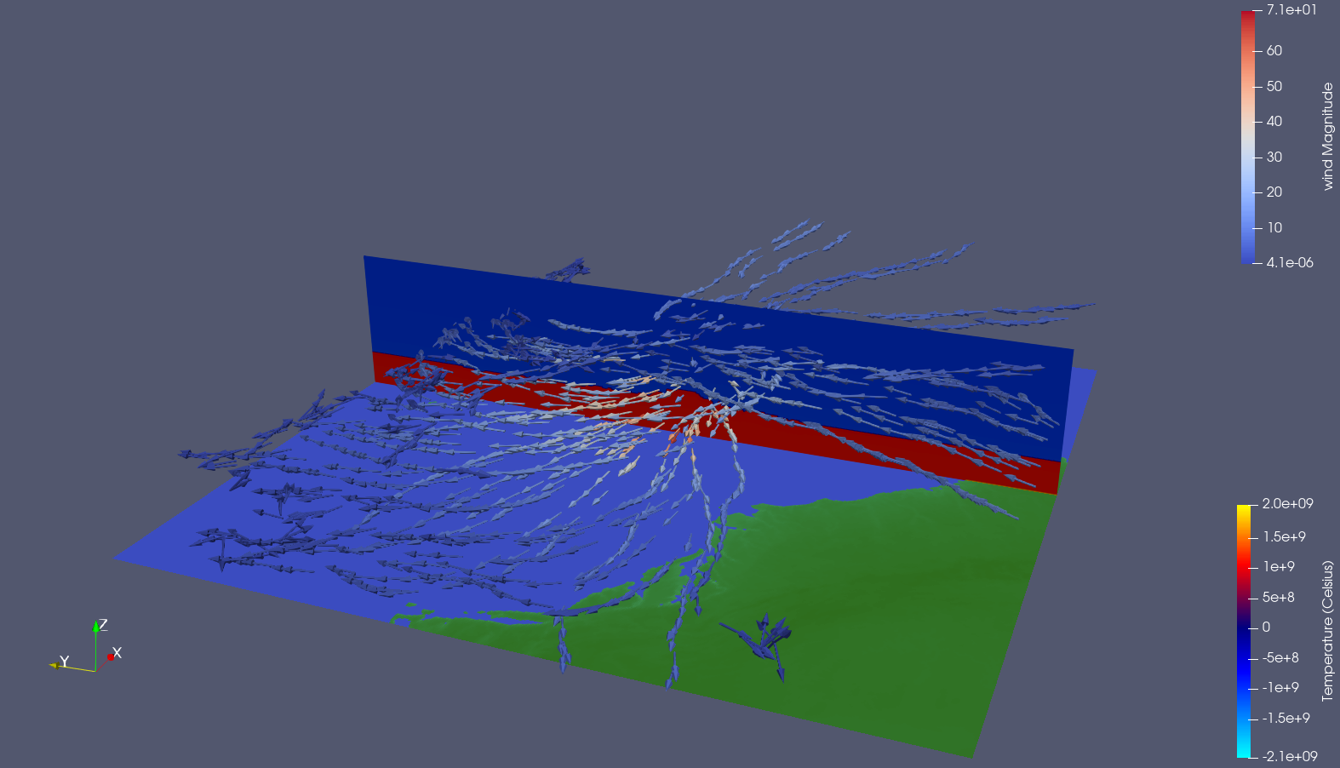
Temperature
Hurricanes need warm ocean water
Stable temperature line until eye of the storm
Likely due to upward draft pushing the air temperature up
Hurricane Isabel

Slide 15
Challenges
Initially data was difficult to work with
Inconsistent format documentation
Data size extremely large
ParaView takes time to learn

Slide 16
Questions?

